Slide 1
Front END MATCH (fem)
High Level Overview

Slide 2
Person Portfolio - PartyID
A person in UCV is uniquely identified by a key called PartyID. A person can have multiple source records linked to their portfolio (PartyID)
e.g.
John Smith |  |  | PartyID 001372180000030
Promoted Source | 011 | ICS generates this source record | John Smith | 123 Main St
Policy Source | 007 | Home Owners | John Smith | 123 Main St
Policy Source | 007 | Auto | Johnny Smith | 123 Main St
Internet Source | 010 | MyAccount | John Smith | 123 Main Av
Direct Source | 003 | Shared Record | Jon Smith | 12 Main St
Claim Participant Source | 002 | NextGen Claim | John Smith | 123 Main St

Slide 3
SearchParty Overview
A new operation called SearchPartyByNameAndAddressForMatch (SFM) was created in the SearchParty service
A new InquiryViewCode (“0060”) was created for the existing SearchPartyByNameAndAddress operation in the SearchParty service. FEM applications should use IVC0060 (if they use this service).
Standard SP uses the input attributes to add each of their MinScores to determine the threshold for returning party candidates in the SP response
When the Foundation receives the IVC0060 then it calculates the MinScore in 2 ways:
Determines the input attributes and adds each of their Minscore values
Only looks at the FirstName/LastName (or FullName if Org) and adds a default 4.5 to calculate the MinScore
The lower value of these will be the threshold used to return party candidates in the SP response
All applications performing FEM will be required to perform a SEARCH to determine if the party they are updating/adding already exists in ICS and to retain the PartyID as part of their transaction flow and send to ICS as part of the subsequent MPR call
Applications can continue to call the standard SP search but if the end-user/agent is unable to determine/find the party from that service call, they must call the new SFM operation
Standardizing the address is highly recommended before performing SFM to ensure the highest possible score
SFM operation will only return data linked to the promoted source (irrespective of what SourceTypeCode is passed on the input request)
SFM operation will require applications to provide full name and address. DOB and SSN is highly recommended (if available)
SFM will only return party candidates that have a score equal to or higher than the auto link threshold of 10.5 (determined by the initiate MEMSCORE API)

Slide 4
Duplicate PartyID Issue (DPI)
An overlay is updating/replacing an existing source record associated to Person-1 containing Personally identifiable information (PII) details that should been applied to Person-2 (where Person-1 and Person-1 are 2 different people)
An overmatch is adding a new source record to Person-1 containing Personally identifiable information (PII) details that should been applied to Person-2 (where Person-1 and Person-1 are 2 different people)
Applications using FEM can still cause overlays/overmatches when processing multiple people on the same quote/policy/claim.
If the people share similar demographic/PII data
If one of those people is already overmatched in the ICS database
Applications can prevent this situation by checking the PartyID(s) returned on the Search response payload
If a PartyID is already assigned to another person on the same quote/policy/claim then this is a potential overmatch situation
If an application is saving PartyID from any process/service outside of the SFM operation, then the application is expected to exclude the duplicate PartyID (i.e. PartyID is already assigned to someone else on the quote/policy/claim) before presenting the search results to the agent/user
If multiple parties were returned by the Search, then those other parties should still be displayed to the agent/user
If no parties remain after excluding the duplicate party, then the application should create a new PartyID (via ICS Maintain services)
Applications are expected to notify ICS of this potential overmatch by sending an event message (over JMS) to ICS containing details of the impacted PartyID
Alternatively, applications using SFM can request UCV to handle the exclusion/notification logic. When adding a new person to a policy/quote/claim and calling SFM to check if person already exists in UCV, applications can pass PartyIDs already stored on the policy/quote/claim. SFM will use this information to handle the exclusion/notification logic
This only applies to SFM calls. If PartyID can be selected by any other means, then the application still needs to handle this logic on their end (e.g. OneBox Search, standard search party)
ICS will generate a SPLIT task in CDW application for review (under a new FEM overmatch queue)

Slide 5
CheckPartyUpdate Overview
Any application performing Frond End Match (FEM) and attempting to update an existing party record in ICS will be required to call the CheckPartyUpdate (CPU) service
The call to CPU should be made before updating any data in ICS
The CPU service will not update any information in ICS
The primary function of the CPU service is to ensure applications are planning to update the correct person (party record)
Applications will pass the information they plan to update along with the key (PartyID/Policy Number/Claim Number) they have on record for that person
The CPU service will compare this information to what ICS already has on record for this person (using the key(s) provided)
The service will return a response indicating whether or not ICS thinks the proposed update is for the same person (PartyID) provided
If not, the service will return a significant change warning. This means the application may have the wrong PartyID on record for the person they want to update
Applications are expected to act upon this warning by prompting the agent/user to confirm if they want to proceed with the update as is

Slide 6
CheckPartyUpdate Overview
The following key + demographic information (when available) should be passed to the CPU service
PartyID (unique identifier for person in ICS)
Claim Number (when applicable)
Policy Number (when applicable)
Prefix
First Name (individual)
Middle Name
Last Name (individual)
Full Name (organization)
Suffix
Gender
Marital Status
DOB (individual)
SSN (individual)
TIN (organization)
Street Address
City
State
ZIP
Phone Area Code
Phone Dial Number
Email Address

Slide 7
CheckPartyUpdate Overview (cont’d)
There is no requirement to call the CPU service, unless an application is planning to update at least one of the following demographic attributes. However, applications may call CPU service for any kind of update if they wish to validate the data they have is in sync with the data stored in UCV as part of the update.
First Name (individual)
Last Name (individual)
Full Name (organization)
DOB (individual)
SSN (individual)
TIN (organization)
Applications that are making updates to any other attribute can proceed directly to the Maintain service call in ICS, without a need to validate the update. The Maintain service call is the service that will apply the update to ICS (either MaintainPartyRelationships or MaintainDirectParty)
This is because ICS already know that changes to any other attribute (e.g. phone and email) will never cause their matching algorithm to trigger a significant change warning
Any planned update that includes any of the above listed attributes could trigger a significant change and would need to be validated before calling the Maintain service call in ICS
The ICS matching algorithm uses probabilistic matching to determine if a significant change would occur
The only confirmation that can be provided prior to calling this service, is as stated above…
If any of the attributes listed above are changing, then there is a possibility this may cause a significant change. It will depend on how many demographic attributes this person already has on record in ICS and whether or not any of those attributes are also changing

Slide 8
CheckPartyUpdate Overview
The CPU service can compare data across 4 different sources records in ICS~
PROMOTED source (i.e. SourceTypeCode tc="011“)
Used when the calling application is adding a new source record to an existing PartyID (e.g. adding a Policy or claim participant to an existing PartyID)
DIRECT source (i.e. SourceTypeCode tc="003“)
Used when the calling application is updating an existing direct source record in ICS
Claim Contacts are stored in ICS at the direct source level, so any updates to a claim contact should use this source compare
Persons on quotes are stored in ICS at the direct source level, so any updates to a person on a quote should use this source compare
POLICY source (i.e. SourceTypeCode tc="007“)
Used when the calling application is updating an existing policy source record in ICS
CLAIM source (i.e. SourceTypeCode tc="002“)
Used when the calling application is updating an existing claim participant source record in ICS
Applications should call CPU service to validate the proposed update against the specific source record they will be changing
e.g. Claim applications should check the ‘002’ and ‘003’ source record
Quoting applications should check the ‘003’ source record
Policy applications should check the ‘007’ source record

Slide 9
CheckPartyUpdate Response - Success
The below <KeyedValue> response indicates a SUCCESS response. The calling application can proceed with the transaction, as there were no significant changes identified to the data already stored in ICS
<ns1:KeyedValue>
<ns1:KeyName>MatchStatus</ns1:KeyName>
<ns1:KeyValue VendorTC="01">01</ns1:KeyValue>
</ns1:KeyedValue>
The below <KeyedValue> response indicates a WARNING response. This means a significant change will occur to the data in ICS if the calling applications proceeds with their transaction. The calling application is expected to review this warning and decide if they want to proceed or perform a new search and/or create a new party record in ICS
<ns1:KeyedValue>
<ns1:KeyName>MatchStatus</ns1:KeyName>
<ns1:KeyValue VendorTC="02">02</ns1:KeyValue>
</ns1:KeyedValue>
If a MatchStatus ‘02’ is returned, then the response payload will also contain embedded before and after payloads of the party data
The BEFORE payload will be the same as the original input data
The AFTER payload will contain the data as it is stored on the ICS database at the time of the service call
These payloads are returned to provide more detailed information to the client. Some FEM applications are using this information to determine which data fields triggered the significant change, so they can display this information to the agent/user

Slide 10
CheckPartyUpdate Response - Failures
The CPU service will return the following response codes, if the PartyID (or SourceID when applicable) from the input request was NOT found in ICS
SourceID is applicable for POLICY requests SourceTypeCode tc="007“
SourceID is applicable for CLAIM requests SourceTypeCode tc="002"
PROMOTED Source Compares (SourceTypeCode tc="011“)
The below <KeyedValue> response indicates the PartyID provided on the input request no longer exists in ICS due to MERGE activity (i.e. the PartyID was merged to a different PartyID)
<ns1:ResultCode tc="1">1</ns1:ResultCode>
<ns1:KeyedValue>
<ns1:KeyName>MatchStatus</ns1:KeyName>
<ns1:KeyValue VendorTC="99">99</ns1:KeyValue>
</ns1:KeyedValue>
The below <KeyedValue> response indicates the PartyID provided on the input request does not exist in ICS (i.e. PartyID is invalid or PartyID was purged in ICS)
<ns1:TransResult>
<ns1:ResultCode tc="5">5</ns1:ResultCode>
<ns1:ResultInfo>
<ns1:ResultInfoCode tc="2001">2001</ns1:ResultInfoCode>
<ns1:ResultInfoDesc>Error From RetrieveParty (ByParty) Foundation service: Data Not found for the Given Inputs</ns1:ResultInfoDesc>
</ns1:ResultInfo>
</ns1:TransResult>

Slide 11
CheckPartyUpdate Response - Failures
The CPU service will return the following response codes, if the PartyID (or SourceID when applicable) from the input request was NOT found in ICS
SourceID is applicable for POLICY requests SourceTypeCode tc="007“
SourceID is applicable for CLAIM requests SourceTypeCode tc="002"
POLICY Source Compares (SourceTypeCode tc="007“)
The below <KeyedValue> response indicates that ICS could not find a relationship between the PartyID and PolicyNumber provided on the input request
(e.g. PartyID may be invalid, PartyID may not exist in ICS, PartyID may have been merged, PartyID may have other relationships other that this policy)
<ns1:ResultCode tc="1">1</ns1:ResultCode>
<ns1:KeyedValue>
<ns1:KeyName>MatchStatus</ns1:KeyName>
<ns1:KeyValue VendorTC="95">95</ns1:KeyValue>
</ns1:KeyedValue>
The below <KeyedValue> response indicates the PolicyNumber does not exist in ICS
<ns1:TransResult>
<ns1:ResultCode tc="5">5</ns1:ResultCode>
<ns1:ResultInfo>
<ns1:ResultInfoCode tc="2001">2001</ns1:ResultInfoCode>
<ns1:ResultInfoDesc>Error From RetrieveParty (ByPolicy) Foundation service: Data Not found for the Given Inputs</ns1:ResultInfoDesc>
</ns1:ResultInfo>
</ns1:TransResult>

Slide 12
CheckPartyUpdate Response - Failures
The CPU service will return the following response codes, if the PartyID (or SourceID when applicable) from the input request was NOT found in ICS
SourceID is applicable for POLICY requests SourceTypeCode tc="007“
SourceID is applicable for CLAIM requests SourceTypeCode tc="002"
CLAIM Source Compares (SourceTypeCode tc="002“)
The below <KeyedValue> response indicates the PartyID provided on the input request no longer exists in ICS due to MERGE activity (i.e. the PartyID was merged to a different PartyID)
<ns1:ResultCode tc="1">1</ns1:ResultCode>
<ns1:KeyedValue>
<ns1:KeyName>MatchStatus</ns1:KeyName>
<ns1:KeyValue VendorTC="99">99</ns1:KeyValue>
</ns1:KeyedValue>
The below <KeyedValue> response indicates that ICS could not find a relationship between the PartyID and ClaimNumber provided on the input request or that the PartyID and/or the ClaimNumber provided on the input request does not exist in ICS
<ns1:TransResult>
<ns1:ResultCode tc="5">5</ns1:ResultCode>
<ns1:ResultInfo>
<ns1:ResultInfoCode tc="2001">2001</ns1:ResultInfoCode>
<ns1:ResultInfoDesc>Error From RetrieveParty (ByParty) Foundation service: Data Not found for the Given Inputs</ns1:ResultInfoDesc>
</ns1:ResultInfo>
</ns1:TransResult>

Slide 13
CheckPartyUpdate Response - Failures
The CPU service will return the following response codes, if the PartyID (or SourceID when applicable) from the input request was NOT found in ICS
SourceID is applicable for POLICY requests SourceTypeCode tc="007“
SourceID is applicable for CLAIM requests SourceTypeCode tc="002"
DIRECT Source Compares (SourceTypeCode tc="003“)
The below <KeyedValue> response indicates the PartyID provided on the input request no longer exists in ICS due to MERGE activity (i.e. the PartyID was merged to a different PartyID)
<ns1:ResultCode tc="1">1</ns1:ResultCode>
<ns1:KeyedValue>
<ns1:KeyName>MatchStatus</ns1:KeyName>
<ns1:KeyValue VendorTC="99">99</ns1:KeyValue>
</ns1:KeyedValue>
The below <KeyedValue> response indicates the PartyID provided on the input request does not exist in ICS (i.e. PartyID is invalid or PartyID was purged in ICS)
<ns1:TransResult>
<ns1:ResultCode tc="5">5</ns1:ResultCode>
<ns1:ResultInfo>
<ns1:ResultInfoCode tc="2001">2001</ns1:ResultInfoCode>
<ns1:ResultInfoDesc>Error From RetrieveParty (ByParty) Foundation service: Data Not found for the Given Inputs</ns1:ResultInfoDesc>
</ns1:ResultInfo>
</ns1:TransResult>

Slide 14
Add/Updating Data in ICS/UCV
The below services offer functionality for FEM applications to add/update PII data in UCV
SOAP/XML over HTTP
MaintainPartyRelationships (MPR)
REST/JSON over HTTP
CreateDirectParty (CDP)
MaintainDirectParty (MDP)
CreateServiceOfferingParty (CSP)
MaintainServiceOfferingParty (MSP)
MaintainPartyRelationships (MPR)
Only used by existing applications that already integrate with UCV/ICS using this service.
New applications should be onboarded to the REST services
This service supports adding new people to ICS/UCV
This service supports updating existing people already in ICS/UCV
This service supports adding new source records to existing people already in ICS/UCV
CreateDirectParty (CDP)
This service only supports adding new people to ICS/UCV
MaintainDirectParty (MDP)
This service supports updating existing people already in ICS/UCV
This service supports adding a direct source record to existing people already in ICS/UCV
CreateServiceOfferingParty (CSP)
This service only supports adding a service offering source record to existing people already in ICS/UCV
MaintainServiceOfferingParty (MSP)
This service only supports updating an existing service offering source record already in ICS/UCV

Slide 15
TOKENS - SNATOKEN
SNATOKEN should be used by client applications that are using the SNA service to standardize name and address information before applying this data to ICS/UCV
The SNATOKEN is returned on the response payload from the SNA service call and this token/value should be passed on the subsequent add/update call to ICS/UCV
The token lets the ICS/UCV service know that the name/address has already been standardized and to save the name/address as entered in the input request payload
Without the token, the ICS/UCV service will attempt to standardize the name/address from the input request payload and it is possible that the value saved in ICS/UCV will be different to the values passed on the input request

Slide 16
TOKENS - FETOKEN
FETOKEN is a token/value returned by the SearchParty service
The token/value is only applicable (in certain situations) when applications are ADDING new people into ICS/UCV. This token is never required for UPDATE transactions.
Within the SFM operation, the FETOKEN is not returned if no persons were found to match the search criteria (irrespective of any exclusion logic – see Slide 4)
SFM will return a FETOKEN when matching candidates were found and returned on the response payload
SFM will return a FETOKEN when matching candidates were found but were excluded from the response payload
(i.e. ResultInfoCode = ‘PO’ on the response payload)
SFM will not return a FETOKEN when no matching candidates were found
If SFM returns matching candidates in the response and the calling application decides that the person they are dealing with was not one of the persons returned on the response payload, they need to retain the FETOKEN as part of their transaction flow and send it to ICS/UCV as part of the subsequent ADD party service call
The FETOKEN will indicate to the service call that a new person (PartyID) is to be added and that any backend matching should be suppressed. Otherwise, it is possible that the service would apply the data to the person the application decided not to choose from the previous Search response
If SEARCH returns no matching candidates in the response but the ResultInfoCode = ‘PO’, they need to retain the FETOKEN as part of their transaction flow and send it to ICS/UCV as part of the subsequent ADD party service call
The FETOKEN will indicate to the service call that a new person (PartyID) is to be added and that any backend matching should be suppressed. Otherwise, it is possible that the service would apply the data to the person the application decided not to choose from the previous Search response

Slide 17
TOKENS - SFMTOKEN
SFM will return a <ResultInfoCode> that the calling applications are expected to temporarily retain as part of their transaction flow
ResultInfoCode = N
No matching candidate was found
ResultInfoCode = S
Single matching candidate was found and returned in the response payload
ResultInfoCode = M
Multiple matching candidate were found and returned in the response payload
ResultInfoCode = PO
Potential overmatch detected. At least one matching candidate was excluded from the response payload
A populated SFMTOKEN is required on every add/update service call to ICS/UCV as part of any FEM flow
The below list covers all possible VALID values that can be passed as a SFMTOKEN. Applications are responsible for passing the correct value on the subsequent add/update service call to indicate Search behaviour prior to the actual add/update service call
U Calling Application identified the PartyID using UCV OneBox service
B Calling Application did not call the SFM service
N Calling Application found no party when calling SFM
S Calling Application selected the single party returned in the SFM service call
SO Calling Application chose not to select the single party returned in the SFM service call
M Calling Application selected a party from the multiple parties returned in the SFM service call
MO Calling Application chose not to select any of the multiple parties returned in the SFM service call
PO Calling Application identified a potential overmatch after reviewing the response from Search
(*note this can be a direct mapping if using SFM or can be determined by application if using other search service*)

Slide 18
TOKENS - CPUTOKEN
CPU will return a <KeyName> of ‘MatchStatus’ and an associated KeyValue. Calling applications are expected to temporarily retain the <KeyValue> as part of their transaction flow.
01 Data Approved
02 Significant Change
Any other response from CPU indicates an error and should be handled before calling any add/update service
A populated CPUTOKEN is required on every add/update service call to ICS/UCV as part of any FEM flow
The below list covers all possible VALID values that can be passed as a CPUTOKEN. Applications are responsible for passing the correct value on the subsequent add/update service call to indicate CheckParty behaviour prior to the actual add/update service call
00 Calling Application did not call the CPU service
01 Calling Application are approved to continue with the add/update
02 Calling Application may be about to cause a significant change to the data on ICS
03 Calling Application got a significant change, x-insured existing party and created a new party in ICS
Soap Format
<ns2:KeyedValue>
<ns2:KeyName>SFMTOKEN</ns2:KeyName>
<ns2:KeyValue VendorTC="S">S</ns2:KeyValue>
</ns2:KeyedValue>
<ns2:KeyedValue>
<ns2:KeyName>CPUTOKEN</ns2:KeyName>
<ns2:KeyValue VendorTC="01">01</ns2:KeyValue>
</ns2:KeyedValue>
REST Format
"token":
{
"searchForMatchToken": "B",
"checkPartyUpdateToken": "01"
}

Slide 19
Event Type Codes
Raw Split Event (not published) (EventTypeCode = 1058)
Raw Merge Event (not published) (EventTypeCode = 1059)
Main Split Event (minus Ivantage data) (EventTypeCode = 1016)
Main Merge Event (minus Ivantage data) (EventTypeCode = 1017)
Ivantage Split Event (EventTypeCode = 1056)
Ivantage Merge Event (EventTypeCode = 1057)
Allstate Policy Split Event (EventTypeCode = 1060)
Allstate Policy Merge Event (EventTypeCode = 1061)
Encompass Policy Split Event (EventTypeCode = 1062)
Encompass Policy Merge Event (EventTypeCode = 1063)
Within the ICS Events Management Infrastructure, the CoreEventsHandler service will generate the raw (1058/1059) split/merge events and route them to the EventsPreprocessor service. The routing rules in EPP will route these events to the SplitMergeEventHandler service. SMEH will send the new events back to EPP, where the EPP routing rules will send them downstream (e.g. to ADW, EDR, etc.)

Slide 20
Event Format - Header
Uses the following schema
https://share.allstate.com/sites/ICS/ICS%20%20Architecture/ICS%20Services/Schemas_1.9/www%20allstate%20com%20technology%20event%20v1_3.xsd
For the embedded payloads, use the following schema
https://share.allstate.com/sites/xml/ics/ICS%20XSDs%20and%20WSDLs/ICS/2017%20April%20Release%20Date%20%20ICS%20Schema%20v2.10/ICS_v2.10.xsd
Standard SPLIT Event Header
<ns0:eventHeader>
<ns0:globalEventId>16093005101386342971040108412842</ns0:globalEventId>
<ns0:publisherEventId>2464918</ns0:publisherEventId>
<ns0:publisherSystemCd>1017</ns0:publisherSystemCd>
<ns0:eventTypeCd>1016</ns0:eventTypeCd>
<ns0:eventCategoryCd>0022</ns0:eventCategoryCd>
</ns0:eventHeader>
Standard MERGE Event Header
<ns0:eventHeader>
<ns0:globalEventId>16093005101386342971040108412842</ns0:globalEventId>
<ns0:publisherEventId>2464918</ns0:publisherEventId>
<ns0:publisherSystemCd>1017</ns0:publisherSystemCd>
<ns0:eventTypeCd>1017</ns0:eventTypeCd>
<ns0:eventCategoryCd>0022</ns0:eventCategoryCd>
</ns0:eventHeader>

Slide 21
Event Format - Info
Standard Event Info (for SPLIT and MERGE)
<ns0:eventInfo xmlns:ns0="http://www.allstate.com/technology/event/v1">
<ns0:eventDateTime>2016-09-30T09:10:13</ns0:eventDateTime>
<ns0:eventSchemaVersion>2010.01.12</ns0:eventSchemaVersion>
<ns0:sourceSystemInfo>
<ns0:systemId>CoreEventsHandler</ns0:systemId>
<ns0:cmsApplicationCd>35</ns0:cmsApplicationCd>
</ns0:sourceSystemInfo>
<ns0:derivedInd>true</ns0:derivedInd>
</ns0:eventInfo>
<eventDateTime> represents the time the event was published within ICS. This time is set by the Initiate software (mainmsg/msghead[1]/pubdatetime) and is published in UTC (GMT) time zone.

Slide 22
Event Format - AttributeList
Standard Event Attributes(for SPLIT and MERGE)
<ns0:eventAttributeList xmlns:ns0="http://www.allstate.com/technology/event/v1">
<ns0:eventAttribute>
<ns0:name>ChangeUserID</ns0:name>
<ns0:value/>
<ns0:dataType>string</ns0:dataType>
</ns0:eventAttribute>
<ns0:eventAttribute>
<ns0:name>ChannelOfUpdate</ns0:name>
<ns0:value/>
<ns0:dataType>string</ns0:dataType>
</ns0:eventAttribute>
<ns0:eventAttribute>
<ns0:name>RequestDateTime</ns0:name>
<ns0:value>2016-09-30T09:10:08</ns0:value>
<ns0:dataType>timestamp</ns0:dataType>
</ns0:eventAttribute>
<ns0:eventAttribute>
<ns0:name>ChangeDateTime</ns0:name>
<ns0:value>2016-09-30T09:10:08</ns0:value>
<ns0:dataType>timestamp</ns0:dataType>
</ns0:eventAttribute>
<ns0:eventAttribute>
<ns0:name>FromParty</ns0:name>
<ns0:value>092070900400300</ns0:value>
<ns0:dataType>string</ns0:dataType>
</ns0:eventAttribute>
<ns0:eventAttribute>
<ns0:name>ToParty</ns0:name>
<ns0:value>003070900400300</ns0:value>
<ns0:dataType>string</ns0:dataType>
</ns0:eventAttribute>
</ns0:eventAttributeList>
<ChangeDateTime> represents the time the event activity occurred within ICS. This time is set by the Initiate software (mainmsg/msghead[1]/sysdatetime) and is published in UTC (GMT) time zone.

Slide 23
Event Format – Embedded Payloads
Every SPLIT and MERGE event will contain 2 embedded Payloads
0001 represents a current image of the data involved in the event activity
0002 represents a before image of the data involved in the event activity
<ns0:eventPayloadList>
<ns0:eventPayload>
<ns0:payloadXML>
<![CDATA[<?xml version="1.0" encoding="UTF-8"?>
<ns0:TXLife xmlns:ns0="http://allstate.com/customerManagement/partyACORDProperties/v2"/>]]>
</ns0:payloadXML>
<ns0:payloadSchemaURL>http://allstate.com/customerManagement/partyACORDProperties/v2
</ns0:payloadSchemaURL>
<ns0:payloadSchemaVersion>2.01</ns0:payloadSchemaVersion>
<ns0:versionExt>
<ns0:payloadTypeCd>0001</ns0:payloadTypeCd>
</ns0:versionExt>
</ns0:eventPayload>
<ns0:eventPayload>
<ns0:payloadXML>
<![CDATA[<?xml version="1.0" encoding="UTF-8"?>
<ns0:TXLife xmlns:ns0="http://allstate.com/customerManagement/partyACORDProperties/v2"/>]]>
</ns0:payloadXML>
<ns0:payloadSchemaURL>http://allstate.com/customerManagement/partyACORDProperties/v2
</ns0:payloadSchemaURL>
<ns0:payloadSchemaVersion>2.01</ns0:payloadSchemaVersion>
<ns0:versionExt>
<ns0:payloadTypeCd>0002</ns0:payloadTypeCd>
</ns0:versionExt>
</ns0:eventPayload>
</ns0:eventPayloadList>

Slide 24
Embedded Payloads – Source Records
Each embedded payload can contain multiple <TXLifeRequest> xml nodes
Each <TXLifeRequest> will represent a source record that was involved in the SPLIT or MERGE event
<TransSubType> can be used to determine what the source record represents
002 is a claim source
<HOClaimReferenceID> represents the ClaimNumber
<CarrierAdminSystem> represents the source of the claim (8 is Legacy. 9 is NextGen)
003 is a direct/shared source
There is no key associated to this record, as it can be updated my multiple applications
Demographic data captured during quoting is stored in this source record
Demographic data associated to claim contacts is stored in this source record
007 is a policy source
<PolNumber> represents the Policy Number
<CarrierAdminSystem> and <CarrierAdminSubSystem> represents the policy admin source system
010 is an internet source
<IDReferenceNo> where <IDReferenceType> = “08” represents the internet logon ID
011 is the promoted source
There is no key associated to this record
This is an internal record generated by ICS

Slide 25
Split and Merge – Guidelines for consuming applications
For consuming MERGE events, applications only need to extract the <FromParty> and <ToParty> details from the <eventAttributeList>
When a merge occurs, the FromParty is no longer active in ICS and is replaced with the ToParty value
All references to the FromParty on application system should be updated to reflect the ToParty value
For consuming SPLIT events, applications need to extract the <FromParty> and <ToParty> details from the <eventAttributeList> but also need to interrogate the embedded payloads to determine what sources were involved in the SPLIT
When a split occurs, the FromParty remains active in ICS but at least one source record previously linked to the FromParty has now been moved to link with the ToParty value
Applications only need to update the PartyID on their system, if they are storing PartyID against a specific source involved in the SPLIT event
e.g. PartyID-1 exists in NG with claim-A and claim-B. Split Event changes PartyID-1 to PartyID-2 on claim-B.
Application should retain PartyID-1 on claim-A but update PartyID-1 to PartyID-2 on claim-B only.

Slide 26
Split and Merge – Daily Volumes
EVENTCODE | EVENTTYPE | AVERAGE DAILY VOLUME
1016 | SPLIT | 150
1017 | MERGE | 15000
1056 | SPLIT | 5
1057 | MERGE | 100
1060 | SPLIT | 120
1061 | MERGE | 1500
1062 | SPLIT | 5
1063 | MERGE | 20

Slide 27
Sample Event Payloads
Split Examples
Merge Examples

Slide 28
FEM Metrics – CPU Events (internal to UCV)
Only certain requests to the CPU service will trigger the service to publish a FEM metric event.
For POLICY source requests (SourceTypeCode tc="007“)
CPU will publish a FEM metric event when service returns a MatchStatus of “01” or “02”.
For ALL source requests
CPU will publish a FEM metric event when service returns a MatchStatus of “02”
Event will use the ACORD event schema/wsdl
https://share.allstate.com/sites/ICS/ICS%20%20Architecture/ICS%20Services/Schemas_1.9/www%20allstate%20com%20technology%20event%20v1_3.xsd
We created a new <eventTypeCd> and <eventCategoryCd> values for this event
<eventTypeCd>3001</eventTypeCd>
<eventCategoryCd>0033</eventCategoryCd>
Each message will contain 2 embedded payloads ~
1st embedded payload should contain the original TxLife request payload mapped from the CPU input request payload
Added a new CMS code to define this as the REQUEST payload - <payloadTypeCd = 0008>
(Domain 11077)
2nd embedded payload should contain a modified version of the TxLife response payload mapped from the CPU output response payload
Added a new CMS code to define this as the RESPONSE payload - <payloadTypeCd = 0009> (Domain 11077)
Events are consumed by a backend service called MaintainFEMMetrics

Slide 29
FEM Metrics – MPR (internal to UCV)
Only certain requests will trigger the service to publish a FEM metric event. Publishing will occur when the input request contains at least one of new FEM tokens
SFMTOKEN
CPUTOKEN
Event will use the ACORD event schema/wsdl
https://share.allstate.com/sites/ICS/ICS%20%20Architecture/ICS%20Services/Schemas_1.9/www%20allstate%20com%20technology%20event%20v1_3.xsd
We created a new <eventTypeCd> and <eventCategoryCd> values for this event
<eventTypeCd>3002</eventTypeCd>
<eventCategoryCd>0033</eventCategoryCd>
Each message will contain 2 embedded payloads ~
1st embedded payload should contain the original TxLife request payload mapped from the MPR input request payload
Added new CMS code to define this as the REQUEST payload - <payloadTypeCd = 0008 >
(Domain 11077)
2nd embedded payload should contain the original TxLife response payload mapped from the MPR output response payload
Added new CMS code to define this as the RESPONSE payload - <payloadTypeCd = 0009>
(Domain 11077)
Events are consumed by a backend service called MaintainFEMMetrics

Slide 30
FEM Metrics – CreateDirectParty & MaintainDirectParty (internal to UCV)
Only certain requests to from these 2 services will trigger them to publish a FEM metric event. Publishing will occur when the input request contains at least one of new FEM tokens
searchForMatchToken
checkPartyUpdateToken
Event will use the ACORD event schema/wsdl
https://share.allstate.com/sites/ICS/ICS%20%20Architecture/ICS%20Services/Schemas_1.9/www%20allstate%20com%20technology%20event%20v1_3.xsd
We created a new <eventTypeCd> and <eventCategoryCd> values for this event
<eventTypeCd>3041</eventTypeCd>
<eventCategoryCd>0033</eventCategoryCd>
Key metric values (e.g. SFMTOKEN and CPUTOKEN) will be passed as <eventAttribute> xml elements in the <eventAttributeList>
Each message will contain 2 embedded payloads ~
1st embedded payload <payloadTypeCd = 0008> should contain the original input request payload as sent on the input request from the calling application. This will be in JSON format.
2nd embedded payload <payloadTypeCd = 0009> should contain the response payload as sent on the output response to the calling application. This will be in JSON format.
Events are consumed by a backend service called MaintainFEMMetrics

Slide 31
FEM Metrics – CreateServiceOfferingParty & MaintainServiceOfferingParty (internal to UCV)
Only certain requests to from these 2 services will trigger them to publish a FEM metric event. Publishing will occur when the input request contains at least one of new FEM tokens
searchForMatchToken
checkPartyUpdateToken
Event will use the ACORD event schema/wsdl
https://share.allstate.com/sites/ICS/ICS%20%20Architecture/ICS%20Services/Schemas_1.9/www%20allstate%20com%20technology%20event%20v1_3.xsd
We created a new <eventTypeCd> and <eventCategoryCd> values for this event
<eventTypeCd>3042</eventTypeCd>
<eventCategoryCd>0033</eventCategoryCd>
Key metric values (e.g. SFMTOKEN and CPUTOKEN) will be passed as <eventAttribute> xml elements in the <eventAttributeList>
Each message will contain 2 embedded payloads ~
1st embedded payload <payloadTypeCd = 0008> should contain the original input request payload as sent on the input request from the calling application. This will be in JSON format.
2nd embedded payload <payloadTypeCd = 0009> should contain the response payload as sent on the output response to the calling application. This will be in JSON format.
Events are consumed by a backend service called MaintainFEMMetrics

Slide 32
FEM Metrics – TOKEN Descriptions
Business Description of FEM_SFMTOKEN
S1
Calling application did not call SFM (as the standard Search request already returned the required data)
S2
Calling application called SFM and no matching party data was found
S3
Calling application called SFM and a single party was returned, from which the calling application selected the PartyID returned in the SFM response
S4
Calling application called SFM and multiple party data was returned, from which the calling application selected a PartyID from the multiple party candidates returned in the SFM response
S5
Calling application called SFM and a single party was returned but the calling application did not select the party returned in the SFM response
S6
Calling application called SFM and multiple party data was returned but the calling application did not select any of the multiple party candidates returned in the SFM response
S7
Calling application used UCV services to identify the PartyID
S8
Calling application called Search services and identified a potential overmatch.
Any other value
Indicates the calling application assigned a handled error code or an invalid value to the SFMTOKEN. This could be a defect for that calling application or (when blank) identify if the ICS service was unavailable

Slide 33
FEM Metrics – TOKEN Descriptions
Business Description of FEM_CPUTOKEN
C1
Indicates the calling application called CPU because they were updating an existing party and the service returned ‘no significant change’
C2
Indicates the calling application called CPU because they were updating an existing party and the service returned a ‘significant change’
C3
Endorsement transaction caused an existing named insured to become x-insured and added a new named insured to the policy
C4
Indicates the calling application called CPU on a New Business transaction and successfully validated the party they are adding the policy will not cause an 'overmatch' type scenario in ICS
C5
Indicates the calling application called CPU on a New Business transaction and were warned that the party they are adding the policy could cause an 'overmatch' type scenario in ICS
C6
Indicates the calling application did not call CPU as the transaction was adding a new party (entity) to ICS
C7
Indicates the calling application bypassed the CPU service call on a New Business transaction
C8
Indicates the calling application bypassed the CPU service call, because they determined that the updates to this party were not significant enough to warrant validating via the CPU service
C9
Indicates the calling application called CPU and the service returned no significant change after post validation determined that only 1 of the four major party attributes (Fname, Lname, SSN, DOB) was changing
Any other value
Indicates the calling application assigned a handled error code or an invalid value to the CPUTOKEN. This could be a defect for that calling application or (when blank) identify if the ICS service was unavailable

Slide 34

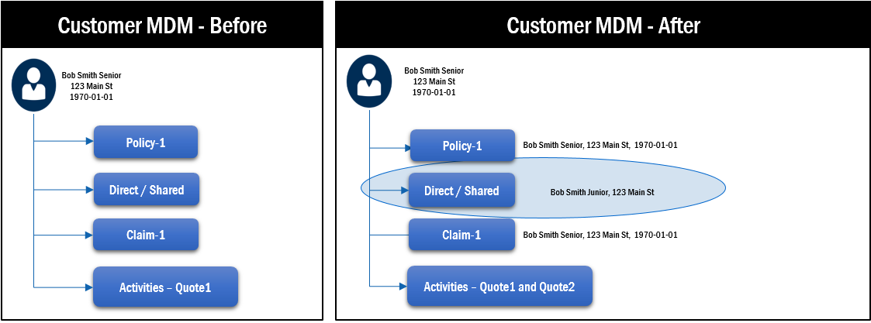
FEM Illustrations
FEM Overview
Person contacts Allstate for the first time for a quote – backend match
Application
e.g. Alliance, Claims, etc
No Search
Demographic data + Quote sent to ICS
ICS performs backend matching to systematically determine if person already exists
Bob Smith Junior
123 Main St
(no DOB provided)
Existing person updated in Customer MDM

Slide 35

FEM Illustrations
FEM Overview
Person contacts Allstate for the first time for a quote – non-FEM with Search (Bad)
Application
e.g. Alliance, Claims, etc
Search
Matching candidates found in Customer MDM
Match Found and
SELECTED
Bob Smith Junior
123 Main St
1990-01-01
Existing person updated in Customer MDM
Customer MDM - Before
Customer MDM - After
Bob Smith Senior
123 Main St
1970-01-01
Bob Smith Senior
123 Main St
1970-01-01
Policy-1
Policy-1
Bob Smith Senior, 123 Main St, 1970-01-01
Direct / Shared
Direct / Shared
Bob Smith Junior, 123 Main St, 1990-01-01
Claim-1
Claim-1
Bob Smith Senior, 123 Main St, 1970-01-01
Activities – Quote1
Activities – Quote1 and Quote2

Slide 36
FEM Illustrations
FEM Overview
Person contacts Allstate for the first time for a quote – non-FEM with Search (Good)
Application
e.g. Alliance, Claims, etc
Search
Matching candidates found in Customer MDM
Match found but
NOT SELECTED
Bob Smith Junior
123 Main St
1990-01-01
New person created in Customer MDM
Customer MDM - Before
Customer MDM - After
Bob Smith Senior
123 Main St
1970-01-01
Bob Smith Senior
123 Main St
1970-01-01
Bob Smith Junior
123 Main St
1990-01-01
Policy-1
Policy-1
Direct / Shared
Direct / Shared
Direct / Shared
Activities – Quote2
Claim-1
Claim-1
Activities – Quote1
Activities – Quote1

Slide 37
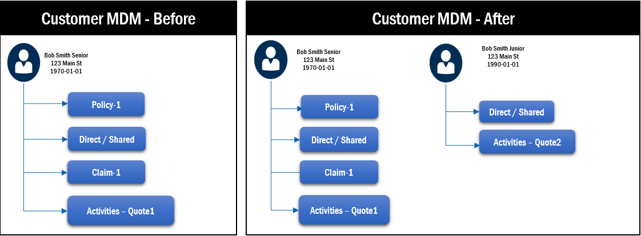
FEM Demo
FEM Overview
Person contacts Allstate for the first time for a quote – FEM Scenario
Application
e.g. Alliance, Claims, etc
Search For Match
(SFM)
No matching candidates found in Customer MDM
No match found
Update not possible
Bob Smith Junior
123 Main St
1990-01-01
New person created in Customer MDM

Slide 38
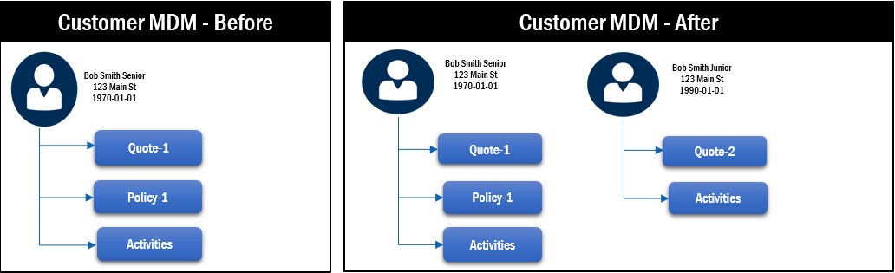
FEM Illustrations
FEM Overview
Person contacts Allstate for the first time for a quote – FEM Scenario (Good)
Application
e.g. Alliance, Claims, etc
Match Found and
SELECTED
Information to be updated is sent for validation
Bob Smith Junior
123 Main St
1990-01-01
Search
(not SFM)
Matching candidates found in Customer MDM
Match found but
NOT SELECTED
CheckPartyUpdate
(CPU)
New person created in Customer MDM
Application decides not to proceed with update
Significant Change warning returned to application

Slide 39

FEM Illustrations
FEM Overview
Person contacts Allstate for the first time for a quote – FEM Scenario (Good)
Application
e.g. Alliance, Claims, etc
Search
(not SFM)
Match Found and
SELECTED
Information to be updated is sent for validation
Robert Smith
123 Main St
Matching candidates found in Customer MDM
CheckPartyUpdate
(CPU)
Existing person updated in Customer MDM
Application decides to proceed with update
Significant Change warning returned to application

Slide 40
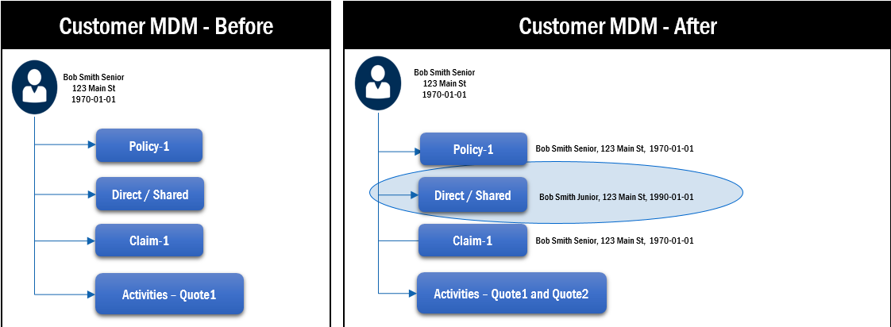
FEM Illustrations
FEM Overview
Person contacts Allstate for the first time for a quote – FEM Scenario (Bad)
Application
e.g. Alliance, Claims, etc
Search
(not SFM)
Match Found and
SELECTED
Information to be updated is sent for validation
Bob Smith Junior
123 Main St
1990-01-01
Matching candidates found in Customer MDM
CheckPartyUpdate
(CPU)
Existing person updated in Customer MDM
Application decides to proceed with update
Significant Change warning returned to application

Slide 41
Ad-Hoc FEM Service - ComparePartyRelationships Overview
The ComparePartyRelationships service will compare party data from the input request against the party data held within ICS for the requested policy number.
The service will support multiple party records being passed on a single input request payload. It will compare each PARTY node on the input request against all the PARTY data associated to the requested policy number in ICS
During this compare process, if a confirmed match can be found against one customer only, the service will return the ICS PartyID and associated customer data on the response
CONFIRMED MATCH = MatchScore value is greater than or equal to 10.5
The actual MatchScore will also be returned for informational purposes
During this compare process, if a potential match can be found against one customer only, the service will return the ICS PartyID and associated customer data on the response
REVIEW MATCH = MatchScore value is between 8.0 and 10.5 (exclusive)
The actual MatchScore will also be returned for informational purposes
During this compare process, if no match can be found, the service will return no PartyID and the requested data will be returned on the response
NO MATCH = MatchScore value is less than or equal to 8.0

Slide 42
Ad-Hoc FEM Service - CreateFEMOvermatchTask Overview
This functional service is not client facing
This service runs 24/7 and picks up new messages (events) from a JMS queue
Each event will contain a PartyID that a FEM application identified as a potential overmatch
Service will use this PartyID to create a ‘split’ task (under the FEM OwnerID)
A new overmatch queue was created in the CDW application to categorize and display FEM system tasks
The operations team will review each FEM split task and take the required actions to resolve the overmatched party

Slide 43
Ad-Hoc FEM Service - FEMMergeGenerator Overview
This functional service is not client facing
This service runs 24/7 and picks up a monthly input file generated out of the monthly ‘Balance & Control’ audits
This input file will contain a list of PartyIDs (from the CDB) that are no longer current because of merge activity
This service will generate a new Allstate policy branded merge event and publish this event to EDR
Service (in it’s current state) would be available to support any FEM application that maintains PartyID on policy record provided that data is accessible through the existing‘Balance & Control’ audits

